Slide 1

RAmDY Car Services LLC
Hirendira Caraveo Aragon

Slide 2


Goal & Challenge
Create
Create a logo
Create
Create a website
Apply
UX design knowledge and dev knowledge a combo of all the classes

Slide 3
About
Finding a place fix your car has never been easier!
Website for a mechanic shop
It is a project that was create a logo, website
I create a logo
Start with social media
Easy Website for all ages but mostly for elders

Slide 4
Audience
Anyone that is looking for a reliable mechanic
Emergency situations

Slide 5




Ideas for a logo
Finals ideas

Slide 6
Final Logo

Slide 7
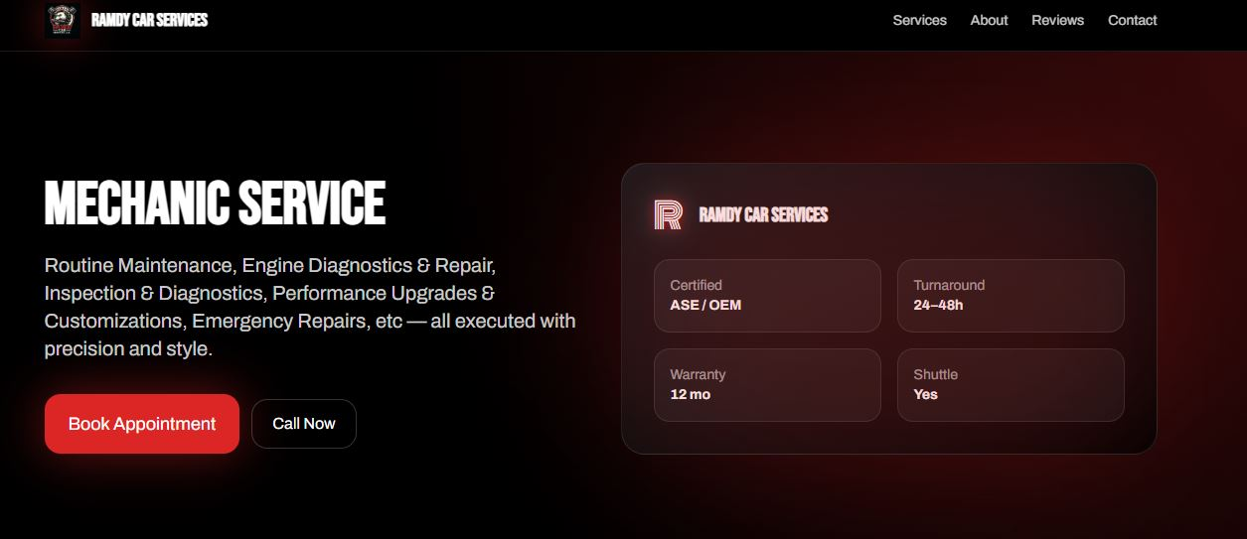
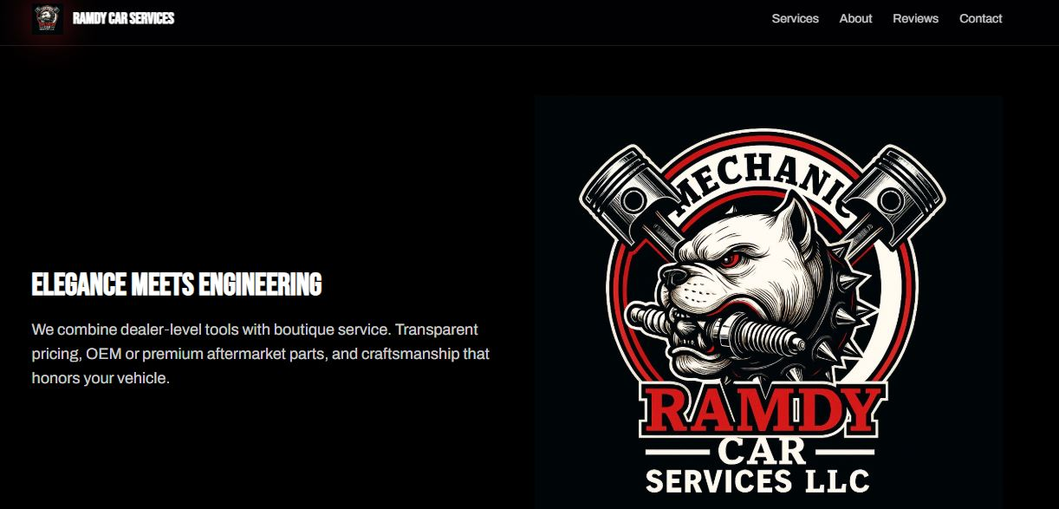
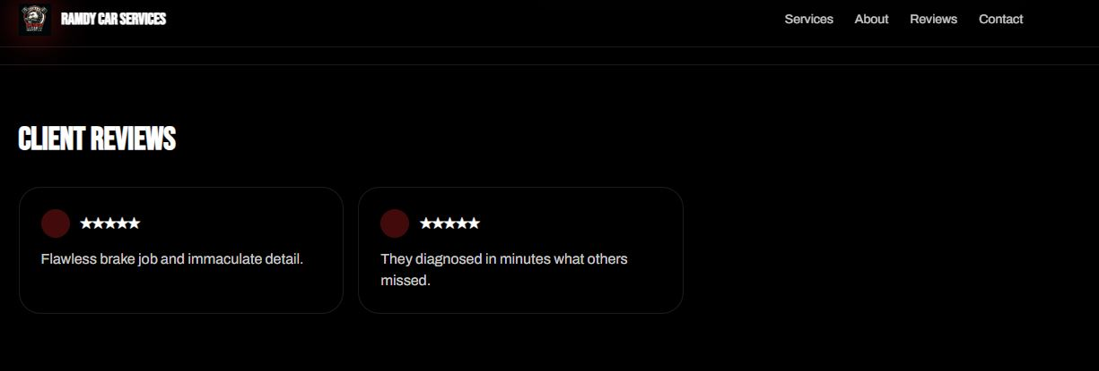
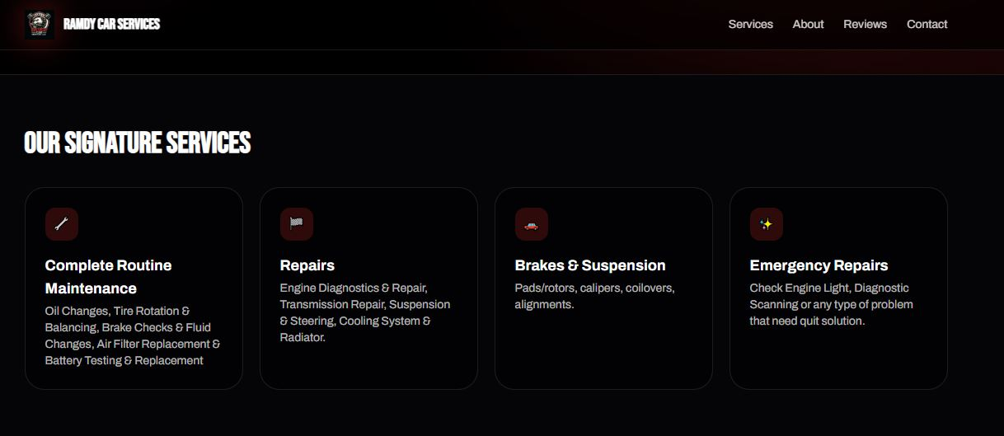
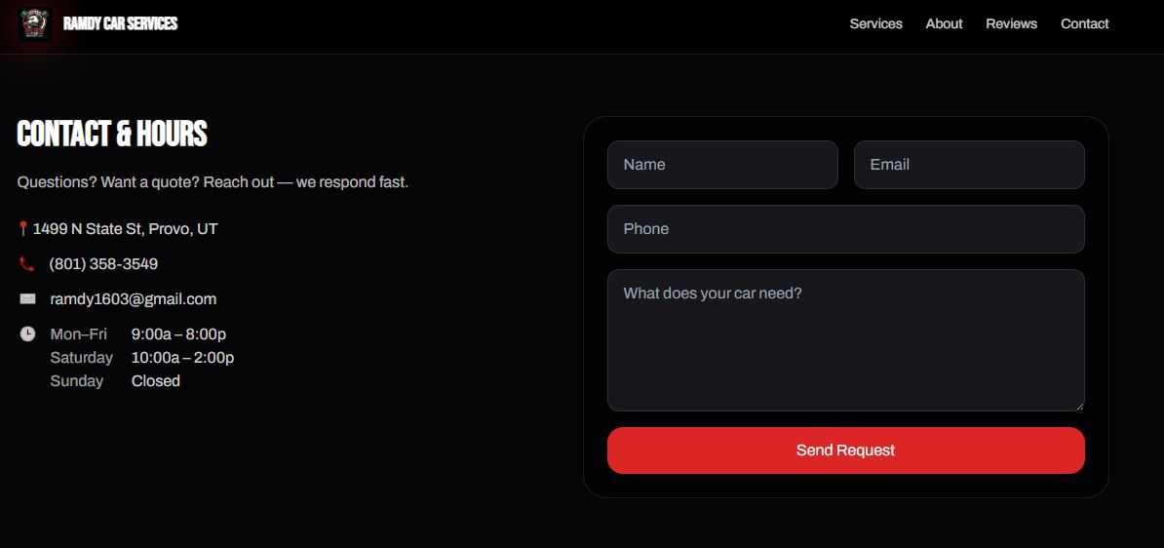
Website http://127.0.0.1:5500/ramdycarservices.html

Slide 8
Example codes
<!-- About -->
<section id="about" class="border-t border-white/10">
<div class="max-w-6xl mx-auto px-4 py-16 grid md:grid-cols-2 gap-10 items-center">
<div>
<h2 class="text-3xl md:text-4xl font-black mb-4 font-head">Elegance meets engineering</h2>
<p class="text-white/80 text-lg">We combine dealer‑level tools with boutique service. Transparent pricing, OEM or premium aftermarket parts, and craftsmanship that honors your vehicle.</p>
</div>
<div class="aspect-[4/3] rounded-3xl]">
<img src="ramdy.jpg" alt="Profile Picture" class="image-style">
</div>
</div>
</section>

Slide 9
Thanks

